Slide 1
Cwricwlwm i Gymru
An enquiry into Assessment
By Ross Bennett and Sarah Cuthbertson

Slide 2
Enquiry Question :
How can a formative and visual approach to assessment develop pupil and parent understanding of progression in Art & DT at key stage 3?
Trials have taken place using new assessment mapping methods with classes of Key Stage 3 pupils in DT and Art. Action research will introduce the relevant ‘What Matter’s Statements’ for our AOLE’s and trail the effectiveness of mapping these in relation to the ‘Progression Steps’ and pupil understanding in Key stage 3.

Slide 3
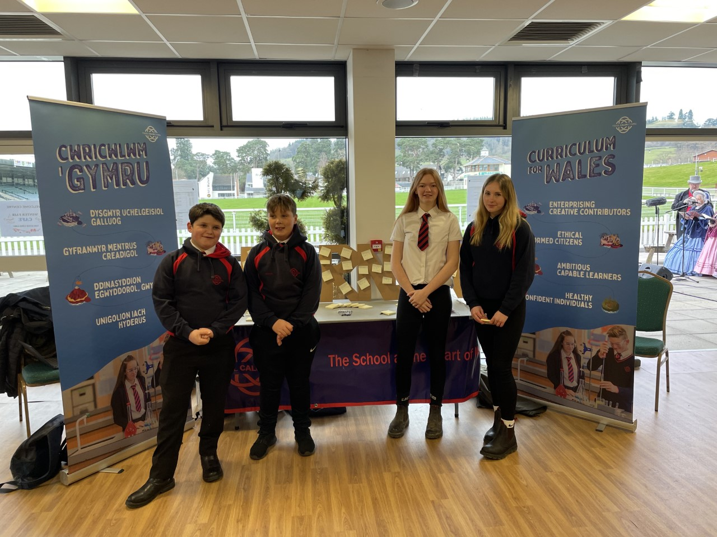
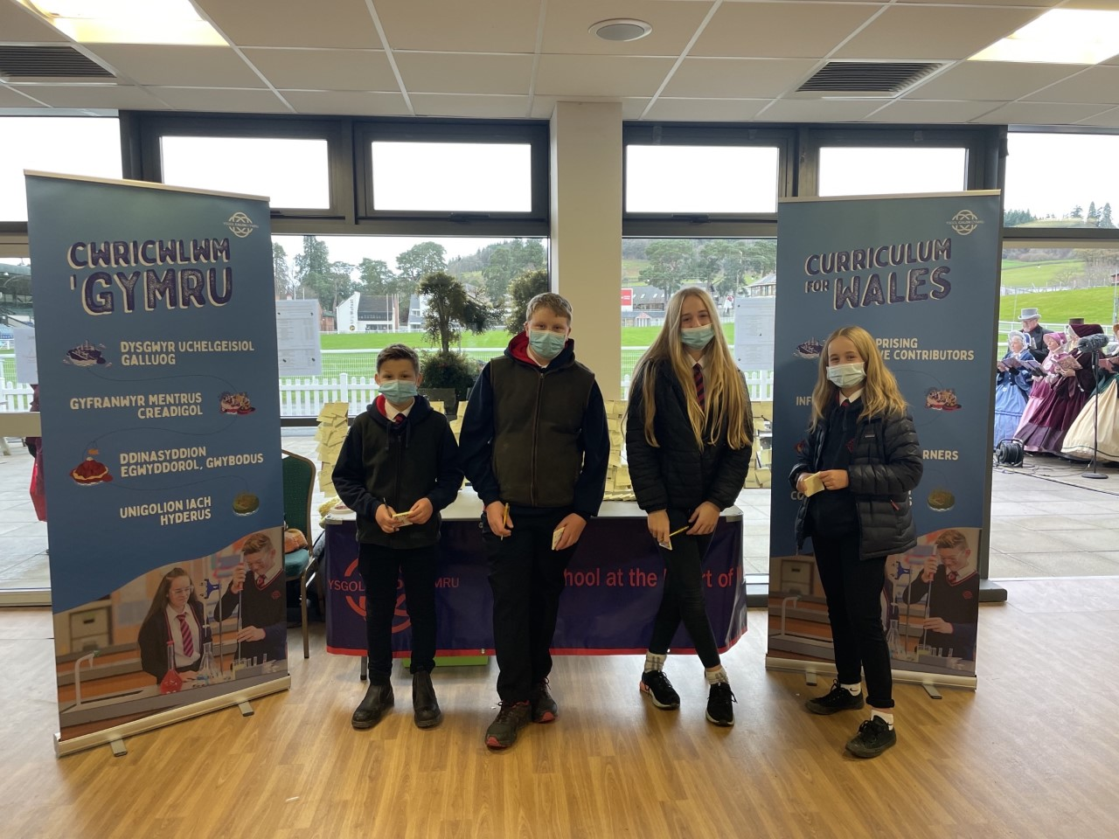
Community engagement RWAS Winter Fayre

Slide 4
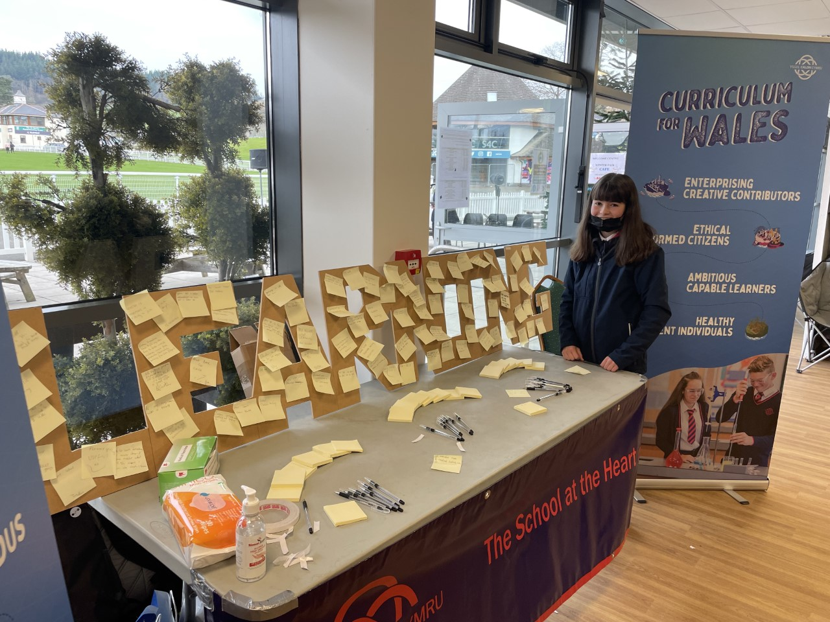
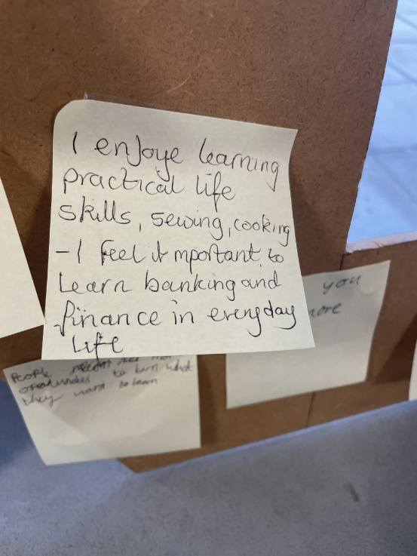
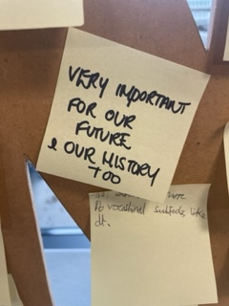
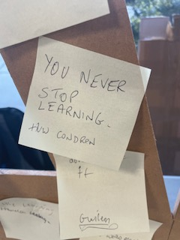

Slide 5
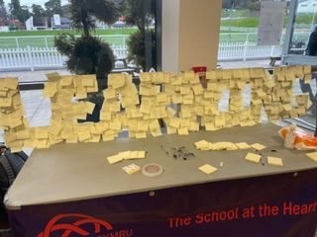
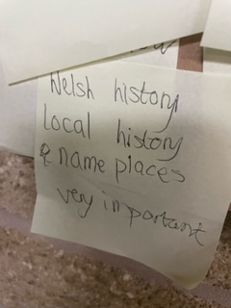
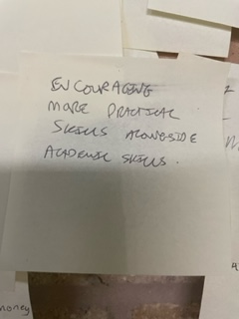

Slide 6
Welsh Culture and History
More practical subjects
Outdoor learning
Focus on finance
Life skills
Welsh language
Well rounded education

Slide 7
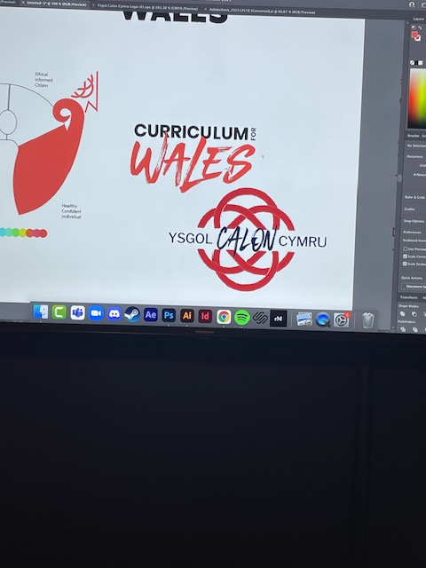
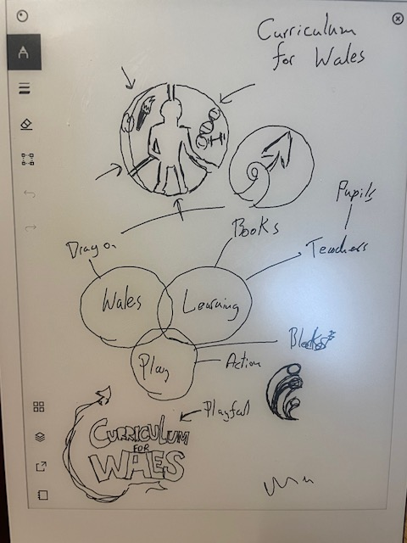
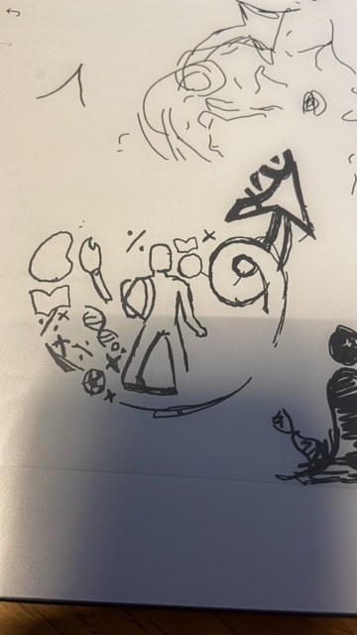
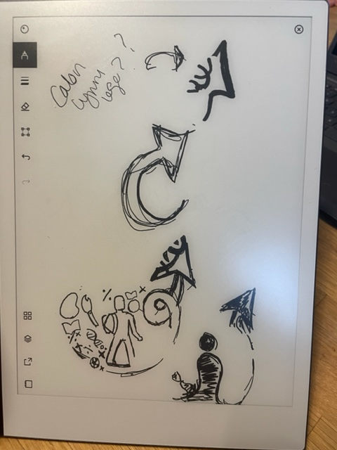
Curriculum for Wales – cluster logo

Slide 8
Pupil feedback
Inclusive
Science
Art
Unity
Shows different subjects
Represents education
Exciting
What people are capable of
Fun learning
Ysgol Calon Cymru
Technology
Bit of everything
Connectivity
Very good logo

Slide 9
‘The better the assessment process, the better the decision; the better the decision, the better the learning’

Slide 10
Disclaimer: This system is just a trial within two classes, in one school on two campuses and is still in its infancy. There are many aspects to discuss further as the Curriculum for Wales unfolds. Our aim is produce a personalized assessment system that visually represents pupils growth. We aim to create a system that reflects pupils fluidity of learning. Along with this, a new vocabulary of assessment must be developed to support the new way we look at assessing our learners.

Slide 11
Referenced
from
Chris Davies’
“Curriculum for Wales
An introduction to
assessment and
Progression”.

Slide 12
Early ideas and discussions
How it started?

Slide 13
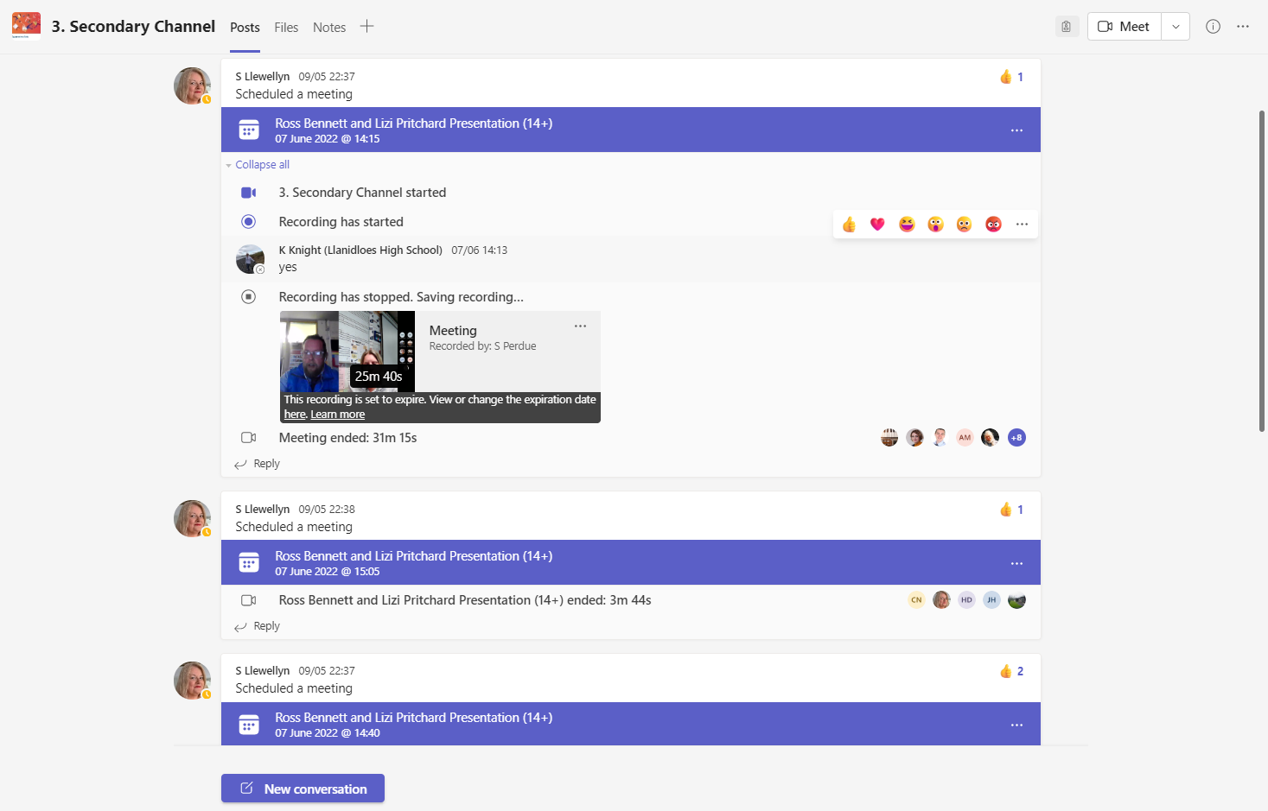
Link to video:
https://hwbwave15.sharepoint.com/sites/ExpressiveArtsAoLENetwork/Shared%20Documents/Forms/AllItems.aspx?id=%2Fsites%2FExpressiveArtsAoLENetwork%2FShared%20Documents%2F3%2E%20Secondary%20Channel%2FRecordings%2FView%20Only%2F3%2E%20Secondary%20Channel%2D20220607%5F141308%2DMeeting%20Recording%2Emp4&parent=%2Fsites%2FExpressiveArtsAoLENetwork%2FShared%20Documents%2F3%2E%20Secondary%20Channel%2FRecordings%2FView%20Only

Slide 14
Early ideas and discussions

Slide 15
Evolution of ideas

Slide 16
Visual Profile development

Slide 17
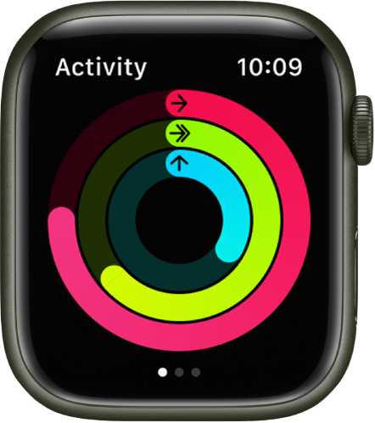
Developing the visual aspect

Slide 18
AOLE
What matters statements
Principles of progression
Skills
Literacy / numeracy / DCF
Descriptions of learning

Slide 19
Science and Technology
PROGRESSION
STEPS
Design thinking and engineering offer technical and creative ways to meet societies needs and wants
1 2 3 4 5
Progress
I can…
Can you…?
I can draw inspiration to design from historical, cultural and other sources
I can identify and prioritise factors which inform my design proposals.
Use this information to design creative solutions?
Justify multiple design factors to improve the effectiveness of my design decisions?

Slide 20
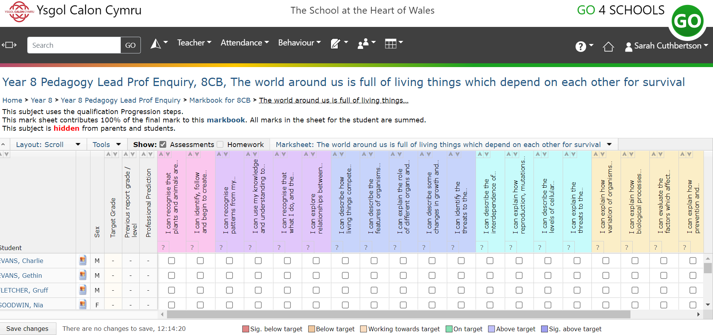
How?
Report home

Slide 21
Science and Technology
Design and Technology Year 8 USB Light Project
Formative report
What a report could look like
Design, thinking & Engineering I can draw inspiration to design from historical, cultural and other sources. I can creatively respond to the needs and wants of the user, based on the context and on the information collected.
I can use design thinking to test and refine my design decisions without fear of failure. I can consider how my design proposals will solve problems and how this may affect the environment.
I can use design communication methods to develop and present ideas, and respond to feedback.
I can combine component parts, materials and processes to achieve functionality and improve the effectiveness of my outcomes.
I can select and safely use appropriate tools, materials and equipment to construct purposeful outcomes. I can use prototyping as a link between my designing and making. I can take into account the impact my making may have on the environment. Can you develop your knowledge and skills to support and refine design decisions in order to produce purposeful outcomes.
The world
around us
Design,
thinking & Engineering
Curious and Searching
I can ask questions and use my experience to suggest simple methods of inquiry.
I can recognise that what I do, and the things I use, can have an impact on my environment and on living things.
I can explore relationships between living things, their habitats and their life cycles.
I can investigate different forms of energy and how it can be transferred.
I can explore and communicate the basic properties of light, sound, electricity and magnetism.
Can you evaluate methods to suggest improvements.
Curious
&
Searching
Computation
Forces & Energy
I can recognise patterns from my observations and investigations and can communicate my findings.
I can use my knowledge and understanding to predict effects as part of my scientific exploration.
I can explore and communicate the basic properties of light, sound, electricity and magnetism.
Can you explain that energy can be transferred from one place to another and how this can be used to provide the energy we need in our modern lives.
Matter
Forces
&
Energy

Slide 22
Science and Technology
Design and Technology Year 8 USB Light Project
Formative report
Dashboard style icon
Design, thinking & Engineering I can draw inspiration to design from historical, cultural and other sources. I can creatively respond to the needs and wants of the user, based on the context and on the information collected.
I can use design thinking to test and refine my design decisions without fear of failure. I can consider how my design proposals will solve problems and how this may affect the environment.
I can use design communication methods to develop and present ideas, and respond to feedback.
I can combine component parts, materials and processes to achieve functionality and improve the effectiveness of my outcomes.
I can select and safely use appropriate tools, materials and equipment to construct purposeful outcomes. I can use prototyping as a link between my designing and making. I can take into account the impact my making may have on the environment. Can you develop your knowledge and skills to support and refine design decisions in order to produce purposeful outcomes.
Design,
thinking & Engineering
The world
around us
Curious
&
Searching
Curious and Searching
I can ask questions and use my experience to suggest simple methods of inquiry.
I can recognise that what I do, and the things I use, can have an impact on my environment and on living things.
I can explore relationships between living things, their habitats and their life cycles.
I can investigate different forms of energy and how it can be transferred.
I can explore and communicate the basic properties of light, sound, electricity and magnetism.
Can you evaluate methods to suggest improvements.
Computation
Forces & Energy
I can recognise patterns from my observations and investigations and can communicate my findings.
I can use my knowledge and understanding to predict effects as part of my scientific exploration.
I can explore and communicate the basic properties of light, sound, electricity and magnetism.
Can you explain that energy can be transferred from one place to another and how this can be used to provide the energy we need in our modern lives.
Matter
Forces
&
Energy

Slide 23
Expressive Arts
Art & Design Year 8 Natural project
Formative report
What a report could look like
Exploring & Developing Skills/Knowledge I can explore and experiment independently and demonstrate technical control with a range of creative materials, processes, resources, tools and technologies showing innovation and resilience. I can explore the effects that a range of creative techniques, materials, processes, resources, tools and technologies have on my own and others’ creative work. I can explore how creative work can represent, document, share and celebrate personal, social and cultural identities. I can explore and describe how artists and creative work communicate mood, feelings and ideas and the impact they have on an audience. Can you explore and experiment with your own and others’ creative ideas, demonstrating increasingly complex technical control, innovation, independent thinking and originality to develop your work with confidence, being able to explain your reasons behind choices made and evaluate their effectiveness on your creative work.
Exploring & Developing Skills/Knowledge
Responding and Reflecting
I can give and consider constructive feedback about my own creative work and that of others, reflecting on it and making improvements where necessary.
I can apply knowledge and understanding of context, and make connections between my own creative work and creative work by other people and from other places and times.
I can reflect upon how artists have achieved effects or communicated moods, emotions and ideas in their work.
Can you reflect upon how artists have achieved effects or communicated moods, emotions and ideas in their work.
Creativity
I can communicate ideas, feelings and memories for an audience and for purposes and outcomes in my creative work
I can create my own designs and work collaboratively with others to develop creative ideas.
I am beginning to demonstrate resilience and flexibility in approaching creative challenges.
I can use creative materials safely and with some control under supervision.
Can you identify and respond creatively to challenges with resilience and flexibility.
Responding and Reflecting
Creativity

Slide 24
Expressive Arts
Art & Design Year 8 Natural project
Formative Report
Dashboard style icon
Exploring & Developing Skills/Knowledge I can explore and experiment independently and demonstrate technical control with a range of creative materials, processes, resources, tools and technologies showing innovation and resilience. I can explore the effects that a range of creative techniques, materials, processes, resources, tools and technologies have on my own and others’ creative work. I can explore how creative work can represent, document, share and celebrate personal, social and cultural identities. I can explore and describe how artists and creative work communicate mood, feelings and ideas and the impact they have on an audience. Can you explore and experiment with your own and others’ creative ideas, demonstrating increasingly complex technical control, innovation, independent thinking and originality to develop your work with confidence, being able to explain your reasons behind choices made and evaluate their effectiveness on your creative work.
Exploring & Developing Skills/Knowledge
Responding and Reflecting
I can give and consider constructive feedback about my own creative work and that of others, reflecting on it and making improvements where necessary.
I can apply knowledge and understanding of context, and make connections between my own creative work and creative work by other people and from other places and times.
I can reflect upon how artists have achieved effects or communicated moods, emotions and ideas in their work.
Can you reflect upon how artists have achieved effects or communicated moods, emotions and ideas in their work.
Creativity
I can communicate ideas, feelings and memories for an audience and for purposes and outcomes in my creative work
I can create my own designs and work collaboratively with others to develop creative ideas.
I am beginning to demonstrate resilience and flexibility in approaching creative challenges.
I can use creative materials safely and with some control under supervision.
Can you identify and respond creatively to challenges with resilience and flexibility.
Responding and Reflecting
Creativity

Slide 25
How?
Report home

Slide 26
On average the provision of high-quality feedback led to an improvement of eight additional months’ progress over the course of a year.
EEF, Sutton Trust and Durham University

Slide 27
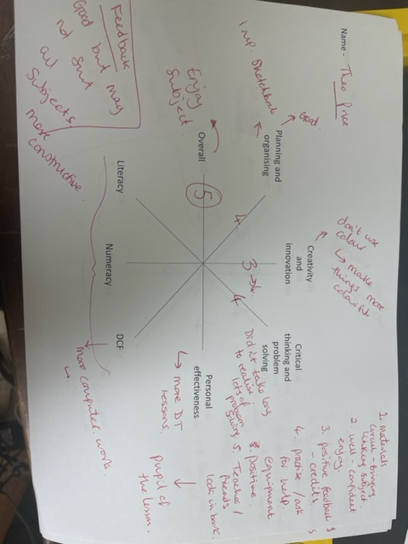
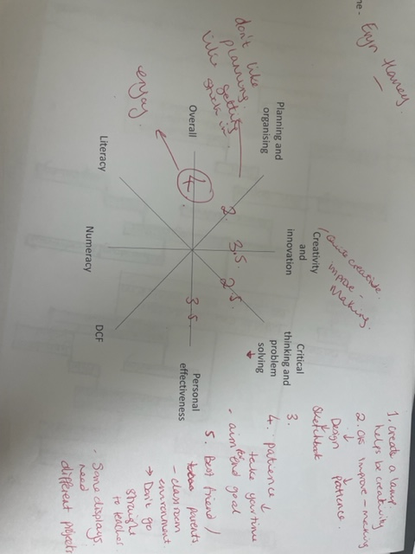
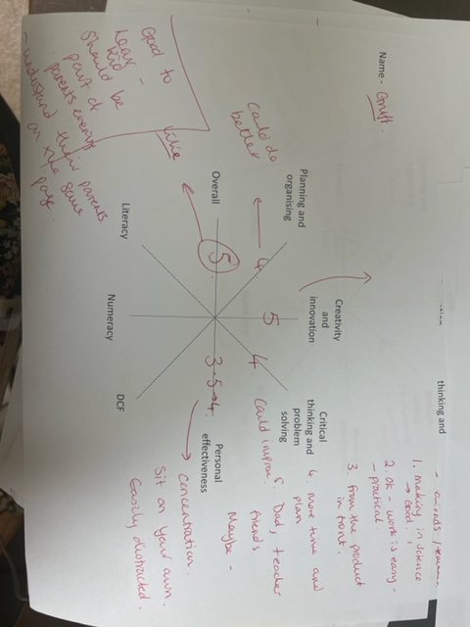
Parents evening
Positive feedback from parents
Enjoyed hearing about their child's learning from their child
More constructive
Begins a deeper conversation around individuals learning journey

Slide 28
Parent Feedback
What are your thoughts on our report?
Do you look at your children’s books?
What are your thoughts on parents evening (school cloud and face to face)
How could we improve parents evening?
Do you feel we provide enough information on how to support your child?
How useful is the information provided to support your child?
What further support could we offer?
Do you feel you are in a dialogue with the school about your child’s progress?

Slide 29
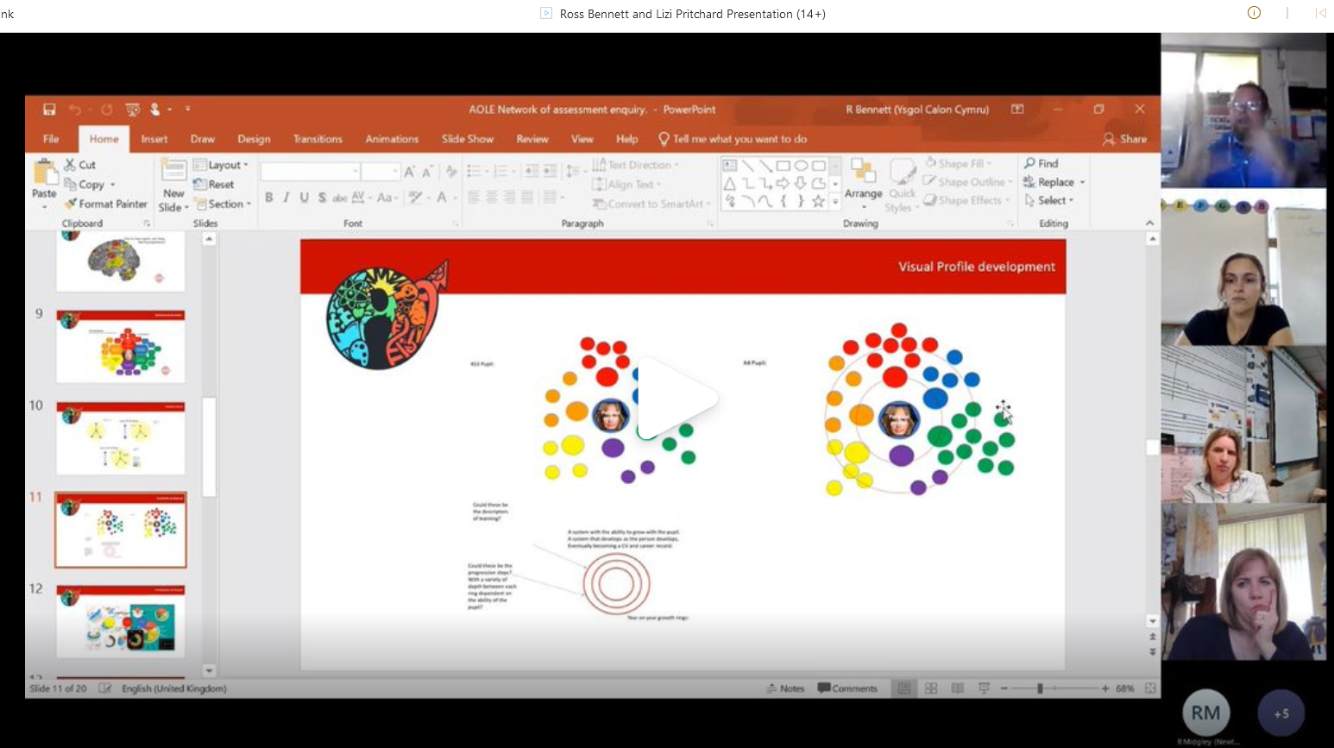
To help explain the Assessment system and the enquiry in greater detail please use the links below to watch
AOLE Expressive Arts Network launch on the 7th June 2022 and the Sci-Tech Network launch on the 12th July 2022.
In this we discuss the wider idea and our focus of the enquiry:
https://youtu.be/QjF0l5mIi74
https://youtu.be/OBl056lTiAY

Slide 30
Going forward
Things to consider:
Create learner friendly statements that support the pupil progress
Avoid tick boxing and matrixes
Review the final parent feedback from the reports
Focus on using the visual element to document the learning journey. In relation to this, we must consider further:
In the implementation of the trial we must ensure the progression steps/descriptions of learning do not become a series of criteria that are being assessed against. We should not be assessing directly against the descriptions of learning/ progression steps, or be undertaking discrete assessment tasks, or independent learning and teaching activities based on them. We should be using the descriptions of learning to provide guidance on the direction and pace of progression to inform our curriculum design and learning and teaching, and use them to develop a wide range of assessment approaches that help determine whether and how progress is being made.

