Slide 1
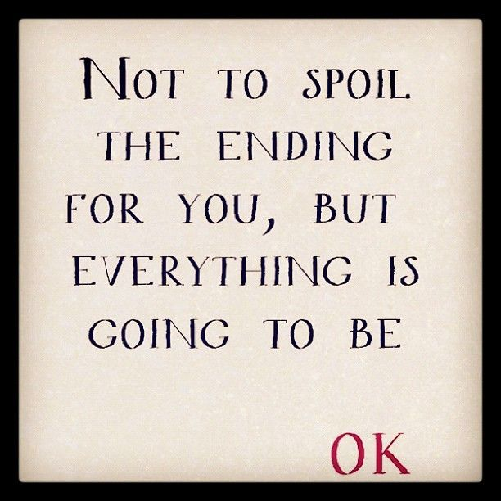

Slide 2
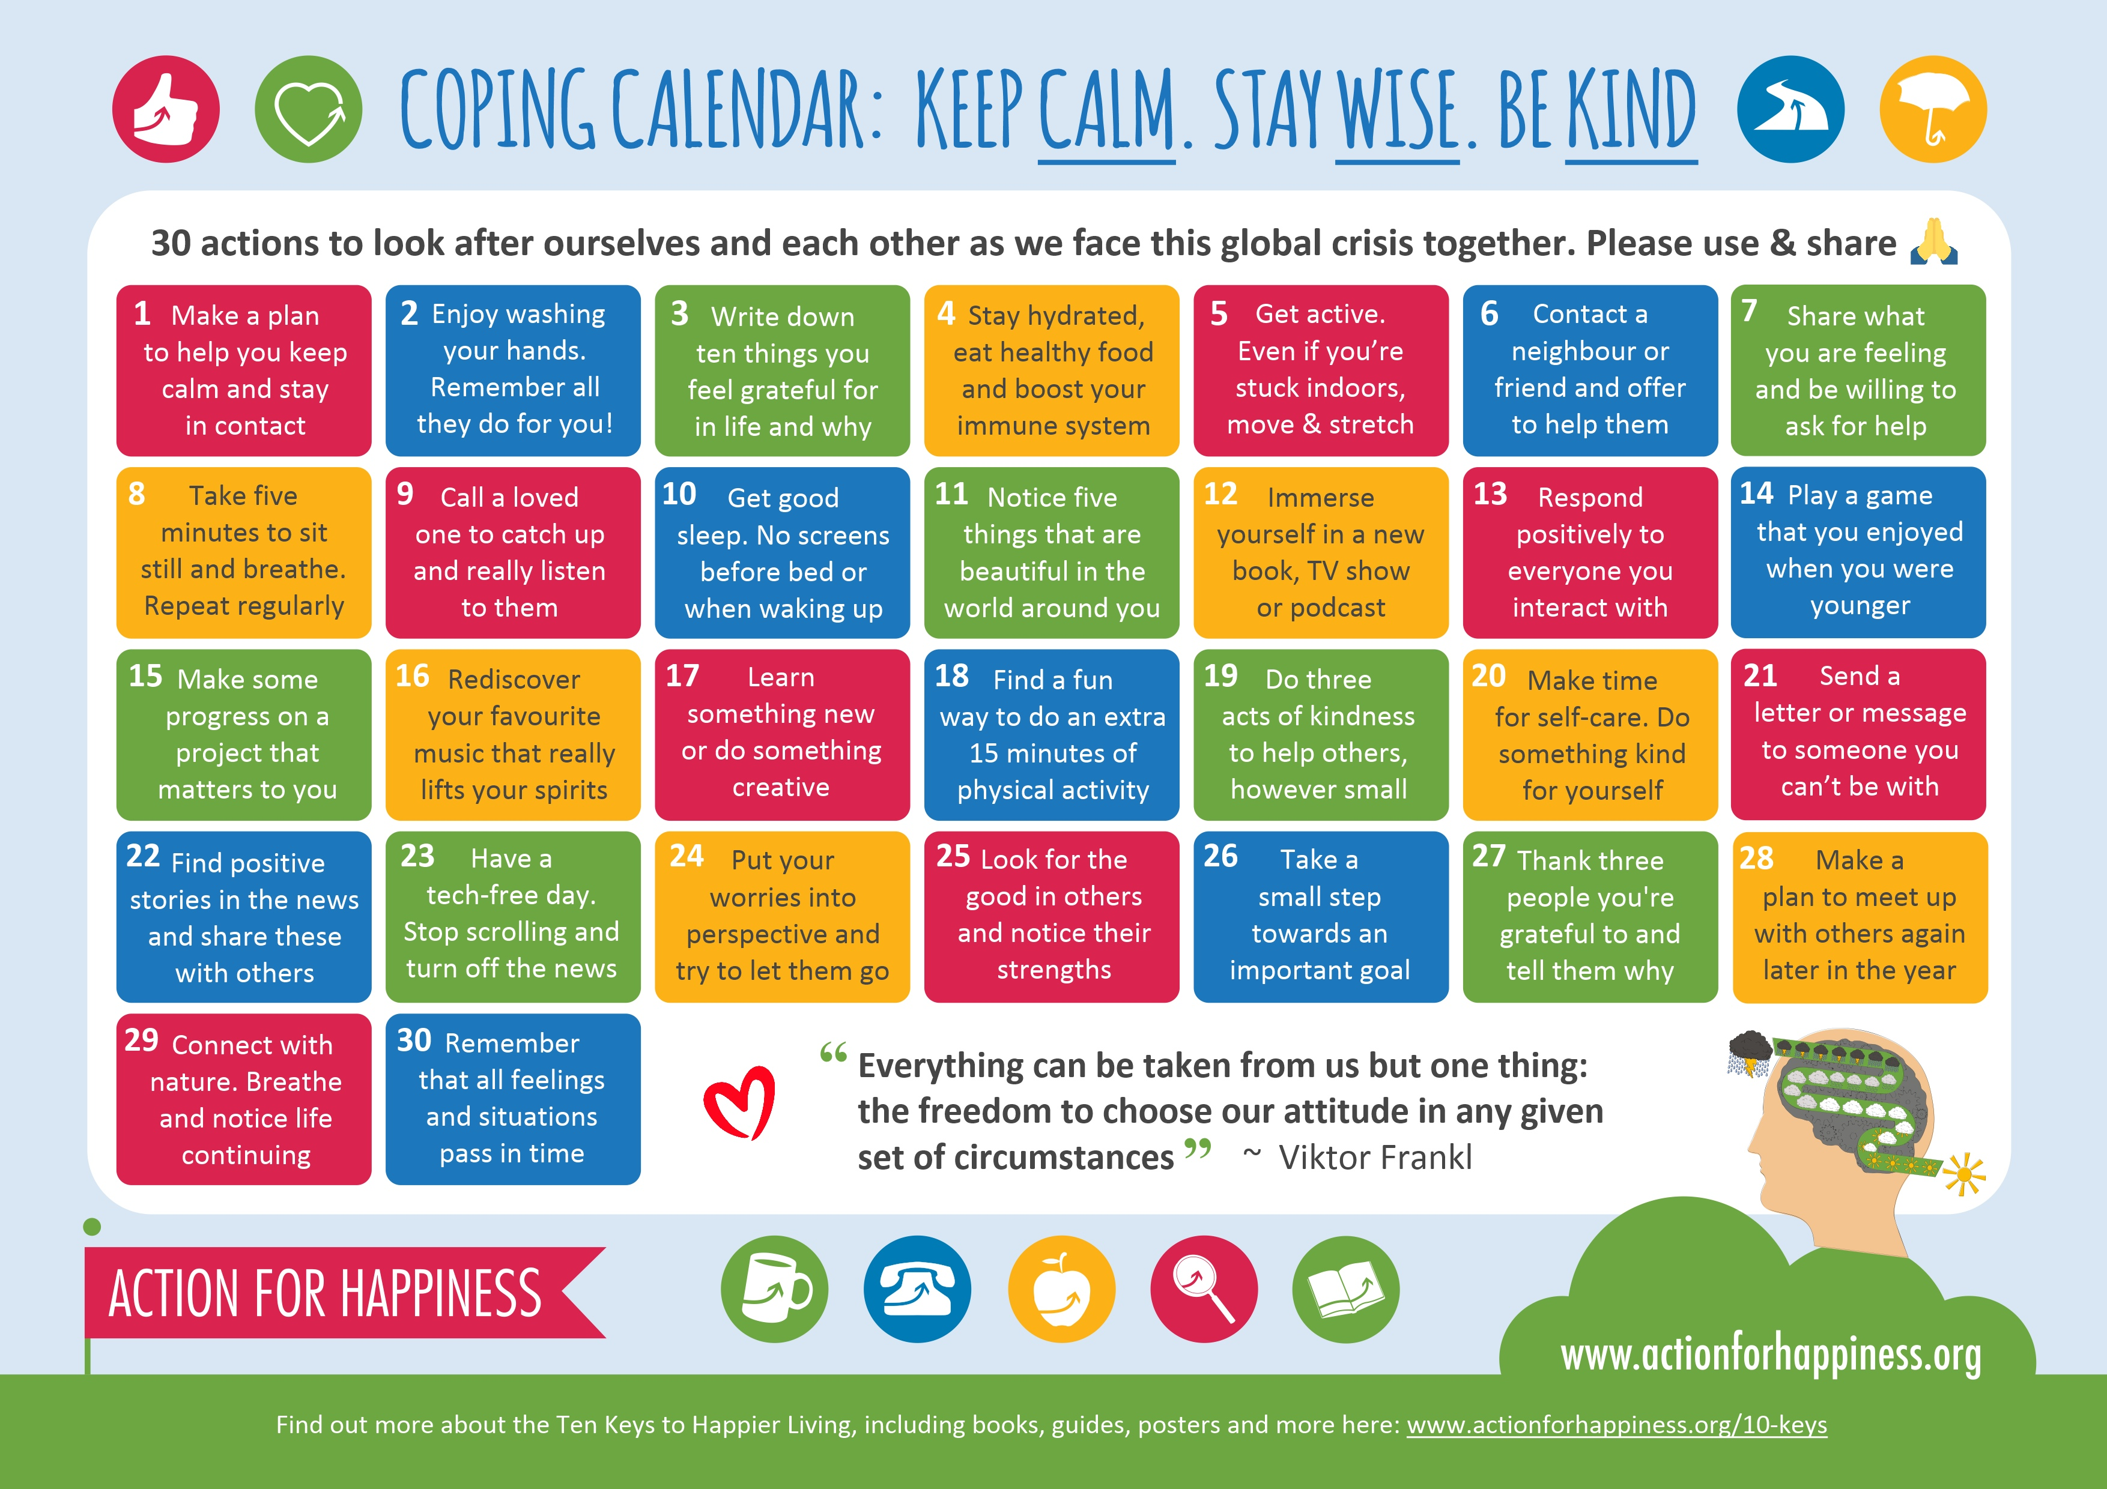

Slide 3
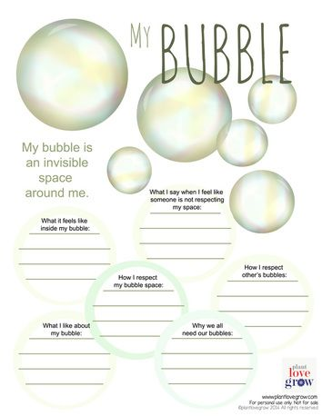

Slide 4
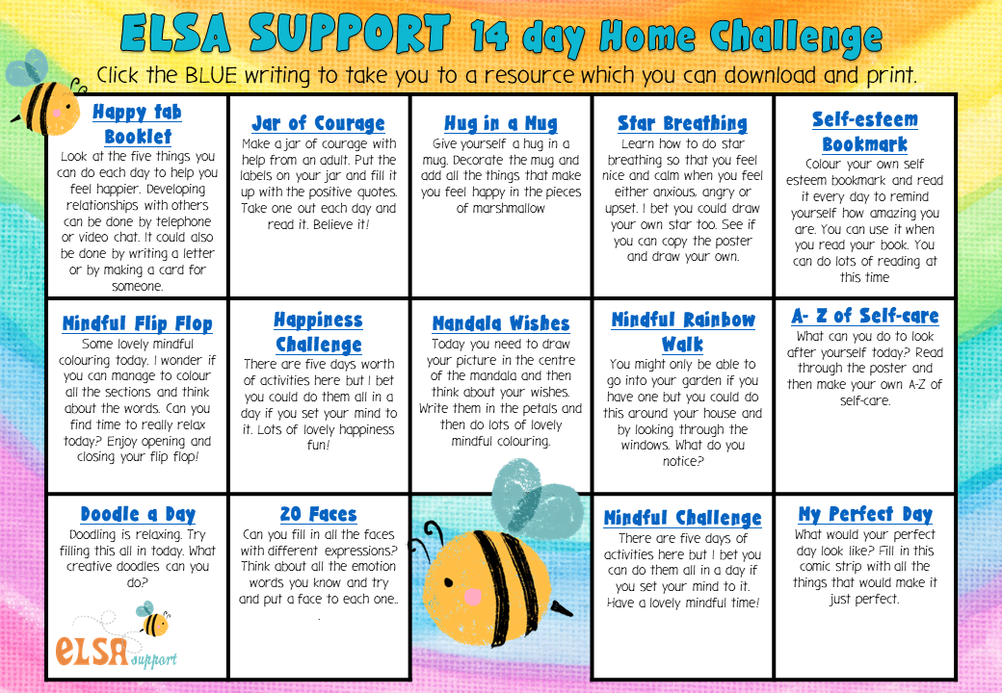

Slide 5
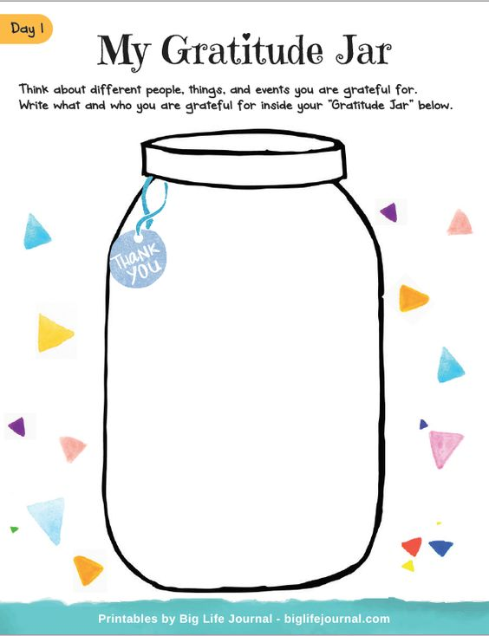

Slide 6
Colour me!

Slide 7
Monday Tuesday Wednesday Thursday Friday Saturday Sunday
FITNESS:
--------------------
Today's goals: ..
1...............................................
2................................................
3................................................
4...............................................
5..............................................
Things to do!
…...................
…...................
…...................
…...................
......................
…...................
…...................
What have I done for myself lately:​
Hydrate

Slide 8
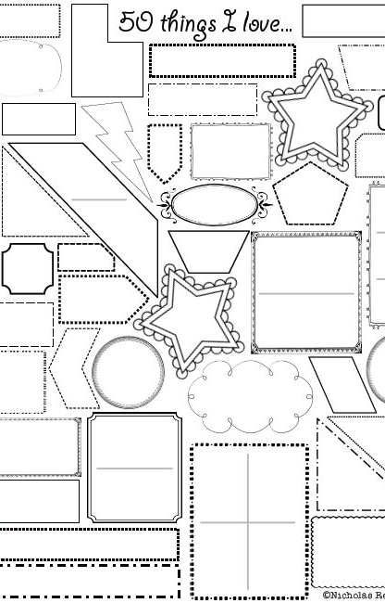
Things that
make me happy

Slide 9
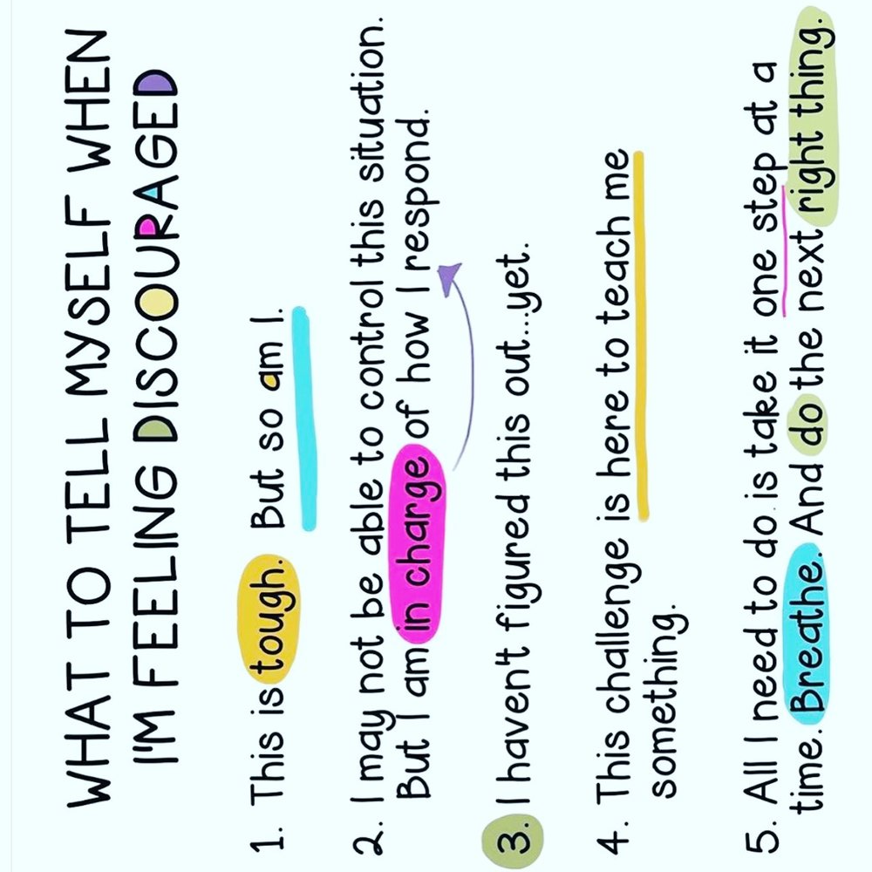

Slide 10
Your mental health is important .
Keep in touch digitally
Make plans to video chat with people or groups you’d normally see in person.
You can also arrange phone calls or send instant messages or texts.
If you’re worried that you might run out of stuff to talk about, make a plan with someone to watch a show or read a book separately so that you can discuss it when you contact each other.
Think of other ways to keep in contact with people while meeting in person is not possible. For example, you could check your phone numbers are up to date, or that you have current email addresses for friends you've not seen for a while.

Slide 11
Decide on your routine
Plan how you’ll spend your time. It might help to write this down on paper and put it on the wall.
Try to follow your ordinary routine as much as possible. Get up at the same time as normal, follow your usual morning routines, and go to bed at your usual time. Set alarms to remind you of your new schedule if that helps.
If you aren’t happy with your usual routine, this might be a chance to do things differently. For example, you could go to bed earlier, spend more time cooking or do other things you don’t usually have time for.
Think about how you’ll spend time by yourself at home. For example, plan activities to do on different days or habits you want to start or keep up.
Agree on a household routine. Try to give everyone you live with a say in this agreement.
Try to respect each other's privacy and give each other space. For example, some people might want to discuss everything they’re doing while others won’t.

Slide 12
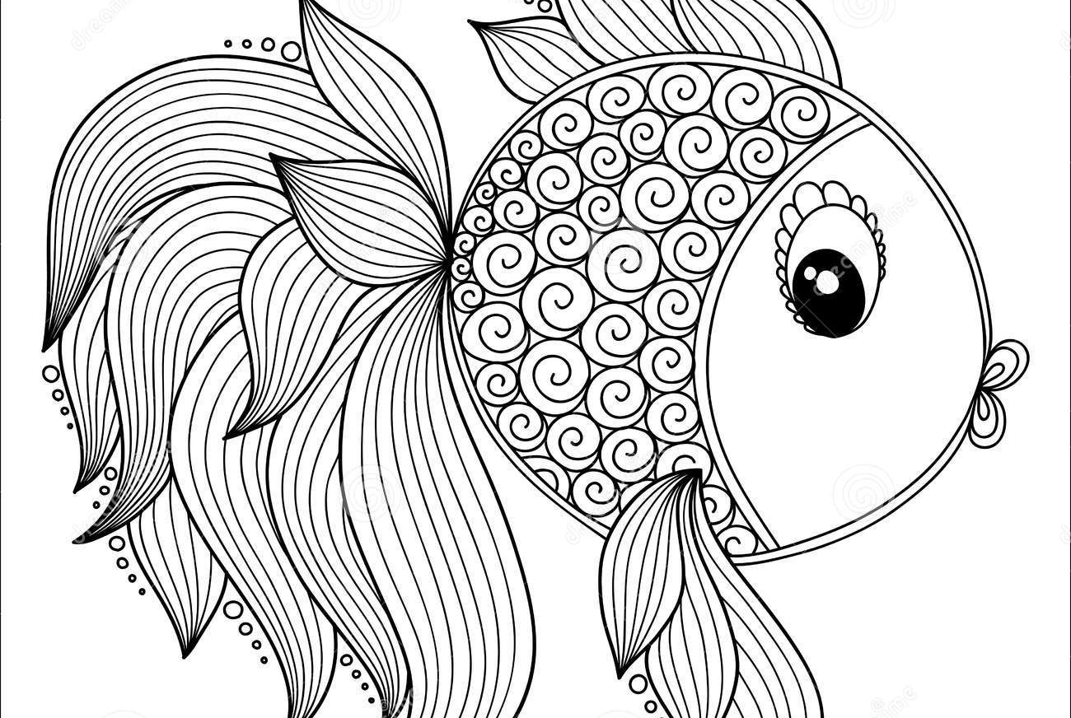
Colour me!

Slide 13
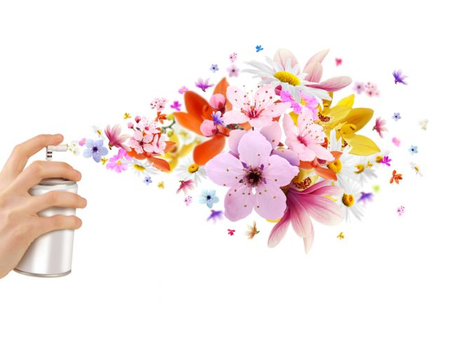
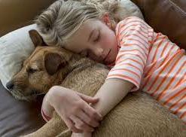
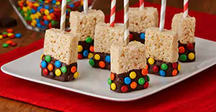
Being in the present...
Think about your favorite:
TASTE
TOUCH
SMELL
SIGHT
SOUND
what could you do?

Slide 14
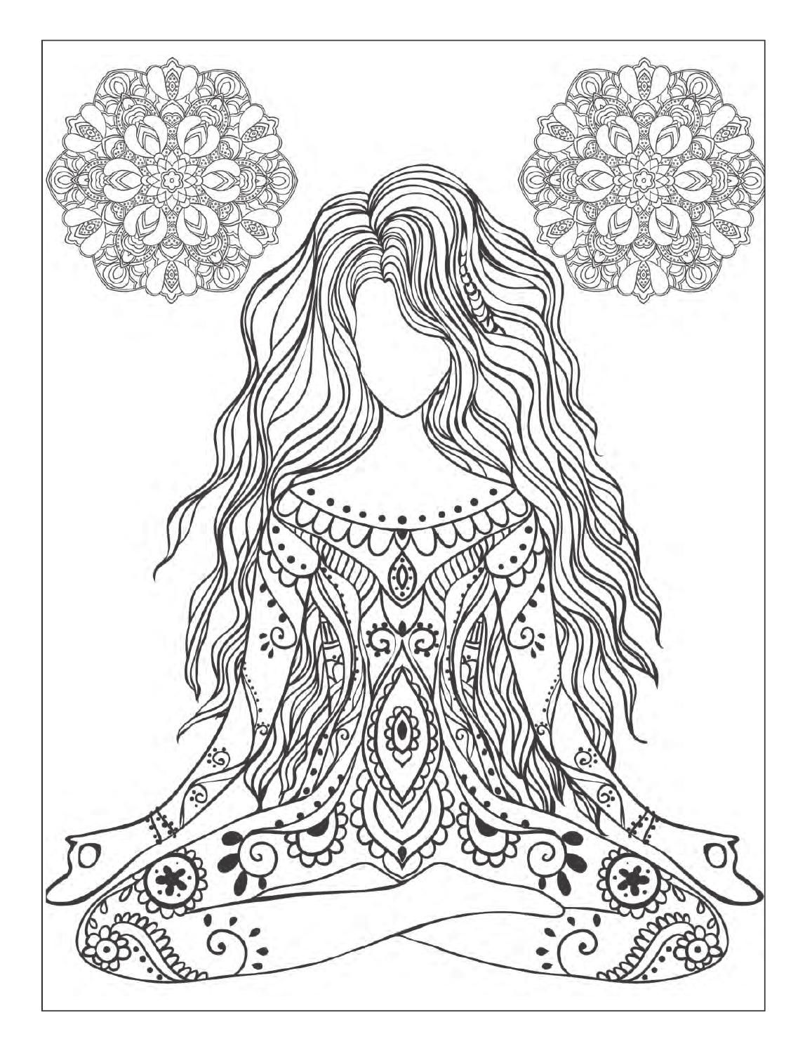
Colour me!

Slide 16
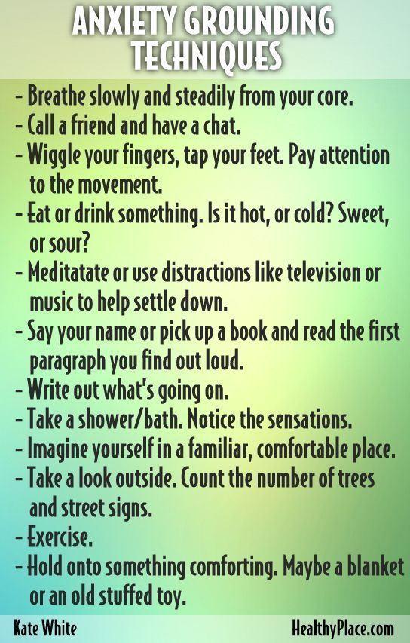

Slide 17
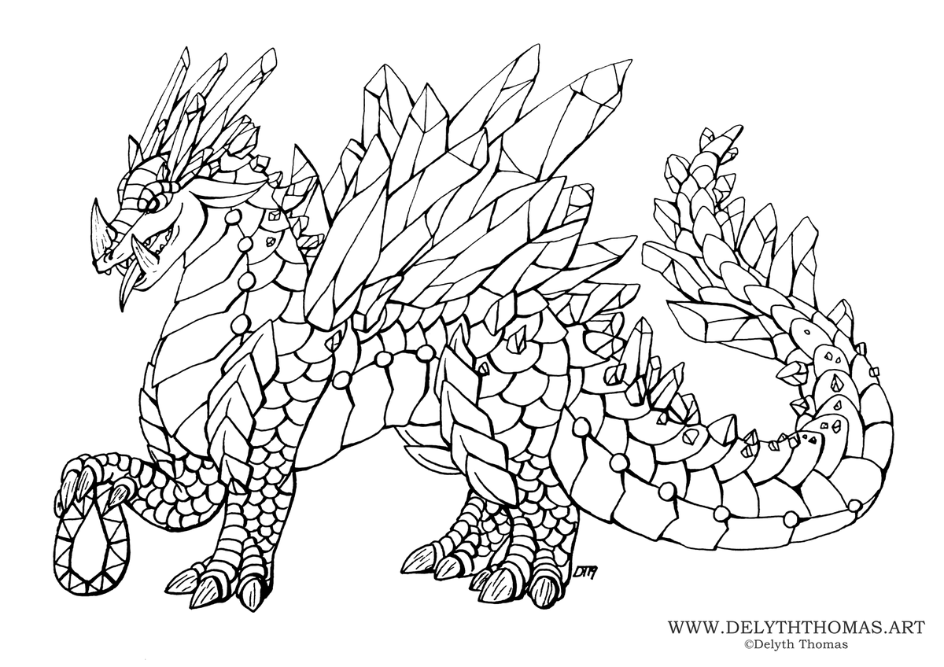
Colour me!

Slide 18
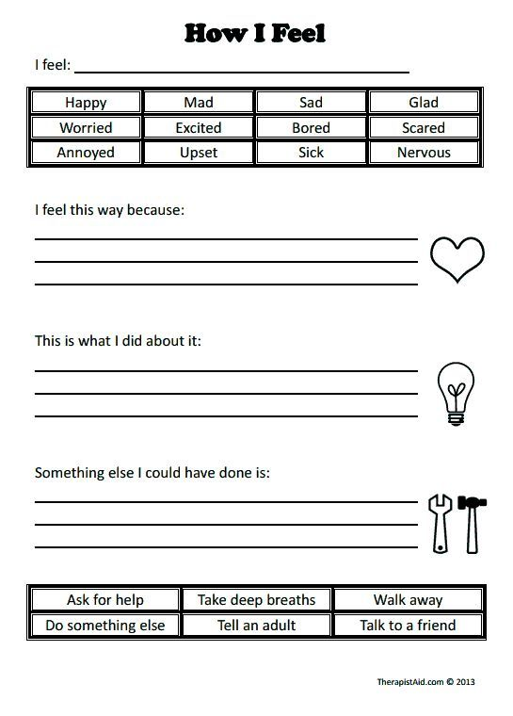

Slide 19
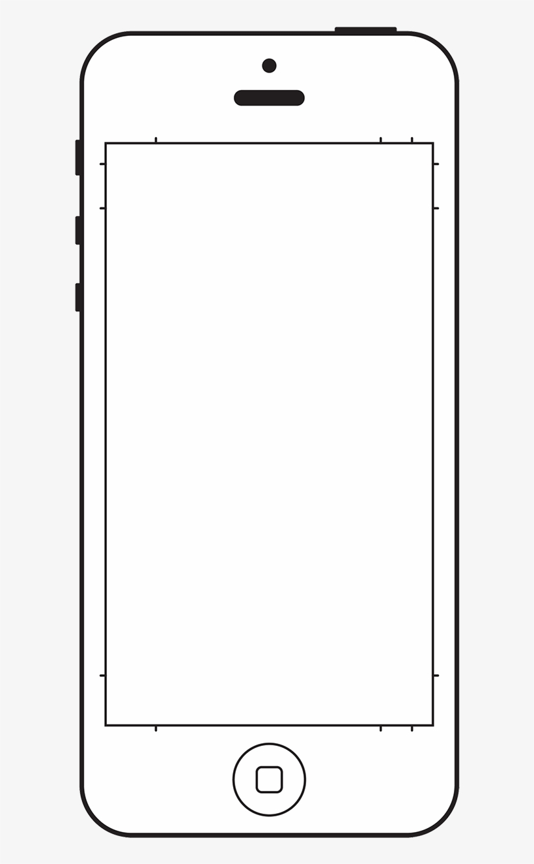
My Favourite book and Music
Fill the spines
Fill the download

Slide 20
Draw what makes you happy

Slide 21
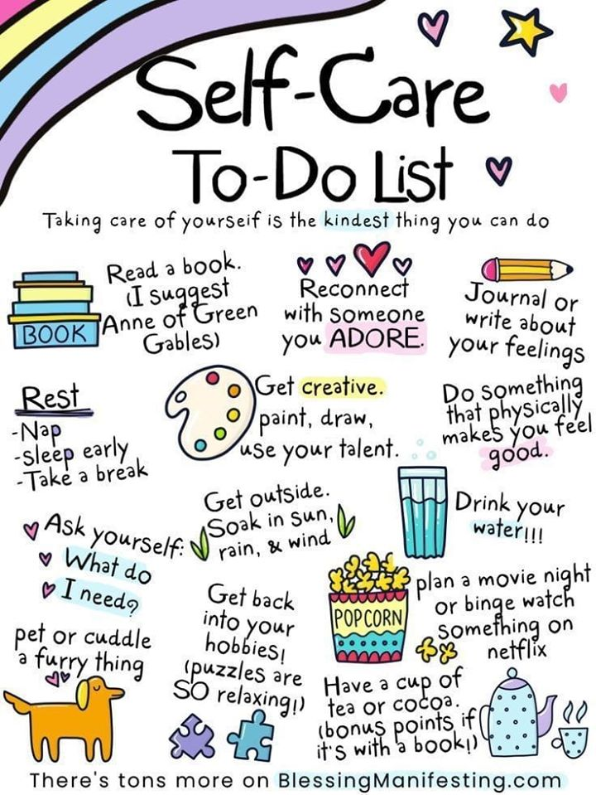

Slide 22
Questions to ask myself:
How am I feeling right now?
What do you love doing that makes you feel happy?
What are you most grateful for?
How am I feeling about this day ahead?
How can you help someone today?

Slide 23
Start and end of the day check in.
Check in at the start of the day.......
Check in at the end of the day........
What was the most important thing I did today?
What gave me the most joy today?
What caused me the most inner conflict and stress?
What am I grateful for?
Do I need to clear anything up?
What do I need to let go?
What are my attention going to be today?
How am I feeling this morning?
What are my goals for the day?
What is the weather like today, how does this affect my mood?
Is there anything I'm not looking forward to today?

Slide 24
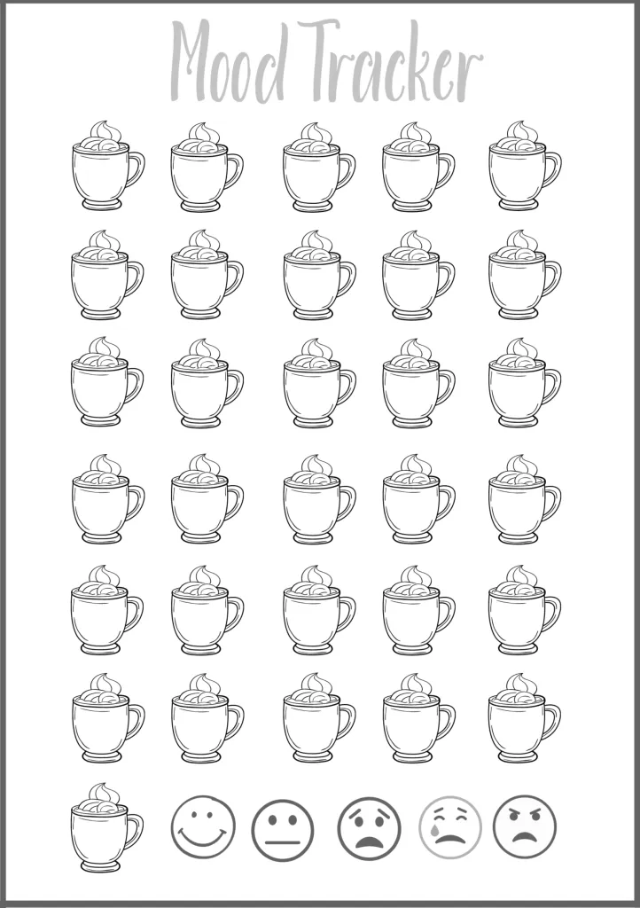

Slide 25
People I can always call on:
Best friend...............................................
A parent..................................................
Grandparents..........................................
Cool sibbling...........................................
Less cool sibbling....................................
Favourite Aunt/Uncle.............................
Owes me a favour..................................
Has a car................................................
Always ready to party............................
Knows everything..................................
Knows just enough................................
One more...............................................

Slide 26
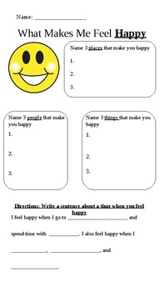

Slide 27
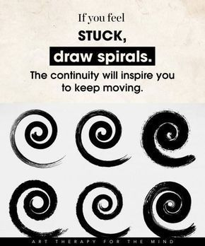

Slide 28
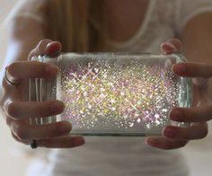
Activity
The Mindful Jar
This activity can teach children how strong emotions can take hold, and how to find peace when feeling overwhelmed.
First, get a clear jar and fill it almost all the way with water. Next, add a big spoonful of glitter glue or glue and dry glitter to the jar. Put the lid back on the jar and shake it to make the glitter swirl. Glue the lid.
Finally, use the following script or take inspiration from it to form your own mini-lesson:
“Imagine that the glitter is like your thoughts when you’re stressed, mad or upset. See how they whirl around and make it hard to see clearly? That’s why it’s so easy to make silly decisions when you’re upset – because you’re not thinking clearly. Don’t worry this is normal and it happens in all of us.
Now put the jar down
Watch what happens when you’re still for a couple of moments. Keep watching. See how the glitter starts to settle and the water clears? Your mind works the same way. When you’re calm for a little while, your thoughts start to settl and you start to see things much clearer. Deep breaths during this calming process can help you settle when we feel a lot of emotions”

Slide 29
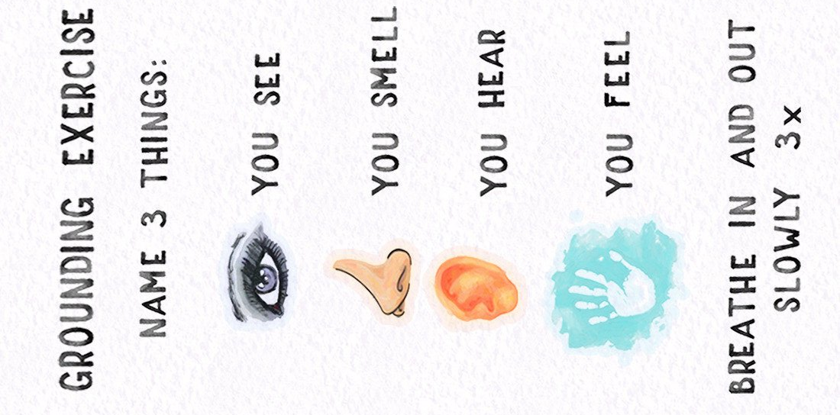
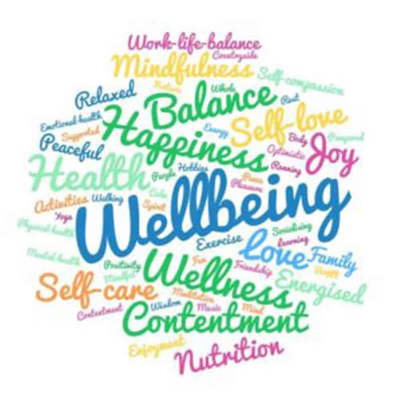
Grounding exercises are things you can do to bring yourself into contact with the present moment – the here and now.

