Slide 1
22 04 24
chwedl
Can you think of any Welsh legends?
Notes:
Ebrill – Wythnos 1
Word of the day – chwedl – legend
Llyn y Fan Fach

Slide 2
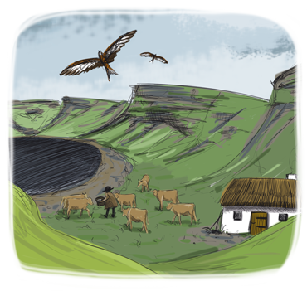
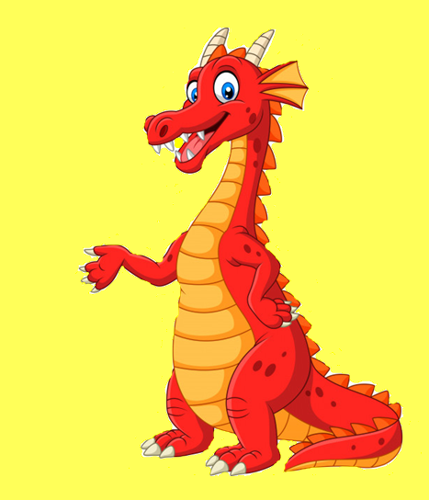
Llyn y Fan Fach
22 04 24
Yn ôl y chwedl, gwelodd ffarmwr lleol ferch brydferth, hudolus yn sefyll ar lan Llyn y Fan. Cwympodd y ddau mewn cariad a chytunodd y ferch ei briodi. Symudodd y ferch o’r llyn i fyw ato fe ar y fferm, yn dod â’i gwartheg, arbennig, gwyn allan o’r dŵr gyda hi. Ond roedd amod: pe tasai’r ffermwr yn codi llaw yn ei herbyn tair gwaith, byddai hi’n dychwelyd at y dŵr. Bu’r pâr yn hapus am flynyddoedd a ganwyd tri mab iddynt, ond un diwrnod tarodd y ffarmwr ei wraig am y drydedd waith. Aeth hi ‘nôl at y llyn gyda’i hanifeiliaid, ond dychwelodd weithiau i rannu ei gwybodaeth am feddyginiaethau naturiol a phlanhigion lleol gyda’i meibion, ddaeth yn enwog fel Meddygon Myddfai.
According to the legend, a local farmer saw a beautiful, enchanting girl standing on the edge of Llyn y Fan Fach. The two fell in love and she agreed to marry him on the condition that, if he struck her three times, she would return to the lake. She left the water to live with him on the farm, bringing her special, white cattle with her. They lived happily for many years, raising three sons, but the day came when he struck her for the third time. She returned to the lake with her animals, but came back to land on occasion to pass her knowledge of herbal medicine and local plants to her three sons, who became famous as the Physicians of Myddfai.
Notes:
Ebrill – Wythnos 1
Word of the day – chwedl – legend
Llyn y Fan Fach

